Slide 1
Predicting No-Shows

Slide 2
Problem of No-Shows
Significant cost if occurs
Displaces a patient who would have shown up
Offices attempt to avoid using “reminder” tactics like SMS messages, emails, phonecall
Goal

Slide 3
Data Collection
Dataset acquired from Kaggle
Doctor’s visits in Brazil over 2016
14 Features
110, 527 observations

Slide 4
Features
01 – PatientId - Identification of a patient
02 – AppointmentID - Identification of each appointment
03 – Gender- Male or Female . Female is the greater proportion, woman takes way more care of they health in comparison to man.
04 –AppointmentDay - The day of the actuall appointment, when they have to visit the doctor.
05 –ScheduledDay- The day the appointment was booked
06 – Age How old is the patient. in years
07 – Neighborhood Where the appointment takes place.
01 – PatientId - Identification of a patient
08 – Scholarship- True of False . Basically was the patient receiving subsidies.
09 – Hypertension- True or False
10 – Diabetes- True or False
11 Alcoholism- True or False
12. Handicap- True or False
13. SMS_received - 1 or more messages sent to the patient.
14. No-show - True or False.

Slide 5
Data Wrangling
No nulls
Appointment & Schedule Days read in as objects
Expanding DateTime columns
Day of week – dt.days attribute
Categorical time of day - pd.cut & dt.hour

Slide 6
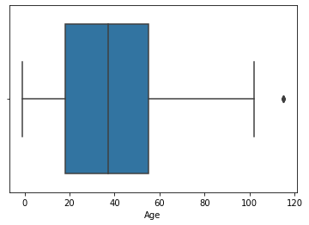
EDA
Natural outliers or erroneous data
Age

Slide 7
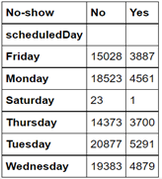
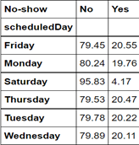
Are any values in a feature disproportionately represented in no shows?

Slide 8
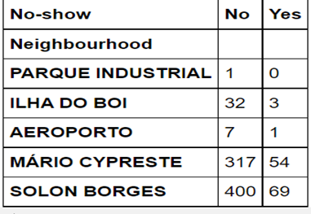
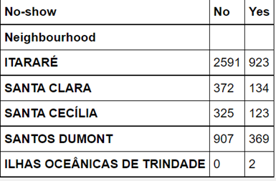
Are any values in a feature disproportionately represented in no shows?

Slide 9
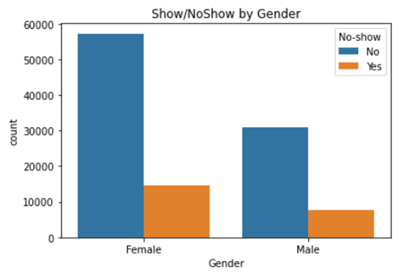
Gender plays no measurable role in no-shows.

Slide 10
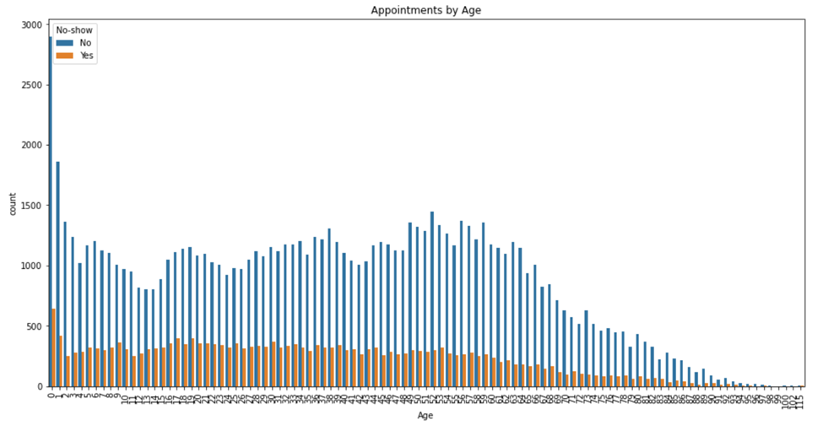

Age & Distribution

Slide 11
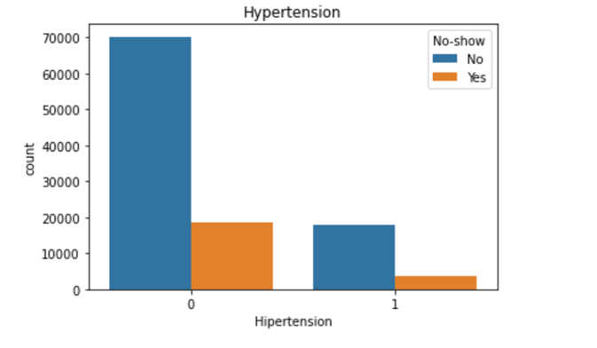
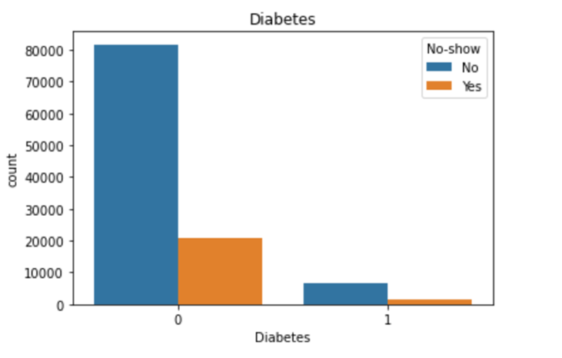

Slide 12
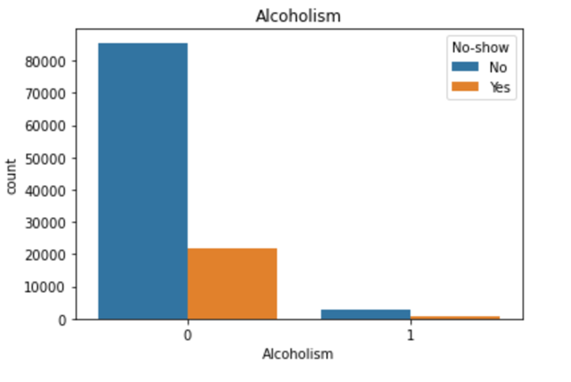
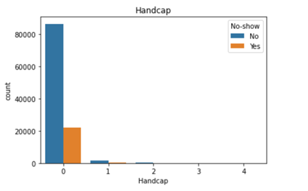

Slide 13
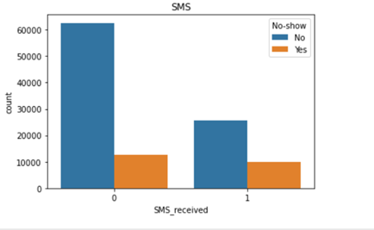

Slide 14
Interval
New column derived by differencing Scheduled Date from Appointment Date
127 unique values
0 – 97
30 unique afterwards
Max 178
58 Interval cut-off
98% quantile

Slide 15
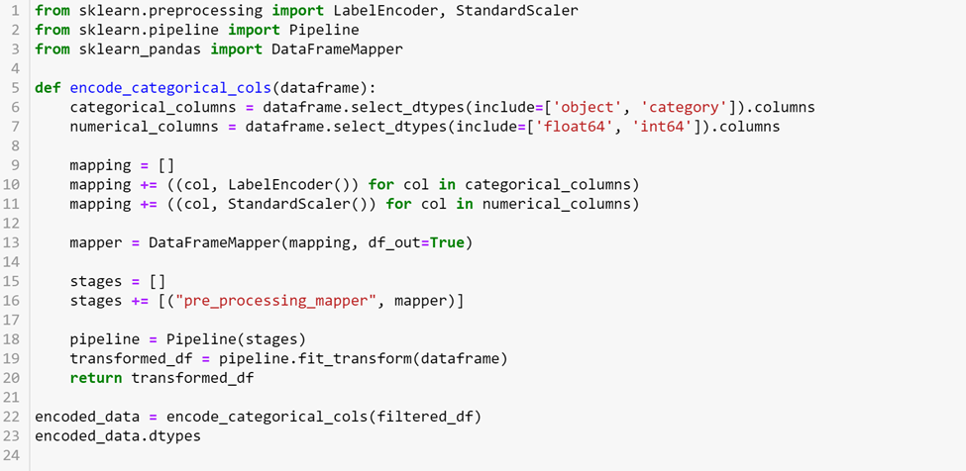
Preprocessing

Slide 16
Modeling - RandomForest
Exhaustive grid search
n_estimator: 800
max_depth: 15
min_samples_split: 2
min_samples_leaf: 1
Mean cross-validated score of best_estimators: 0.8016363700874904

Slide 17
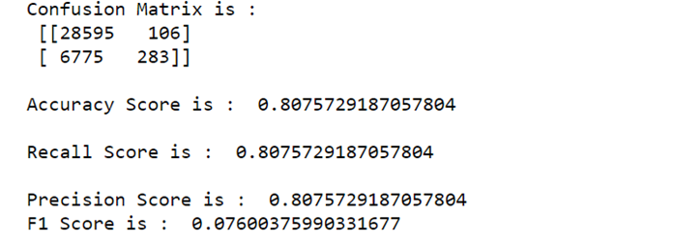
Confusion Matrix

Slide 18
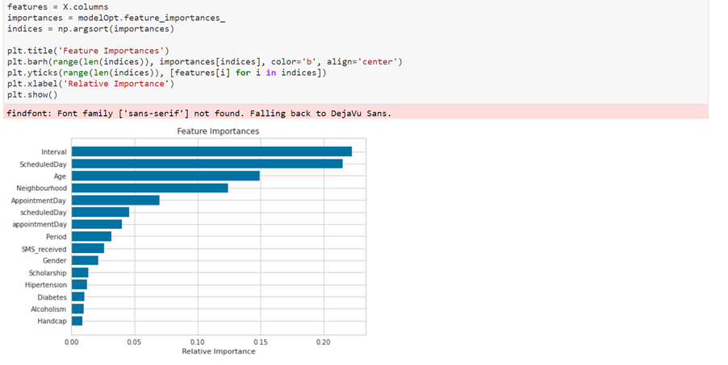
Feature Importance

Slide 19
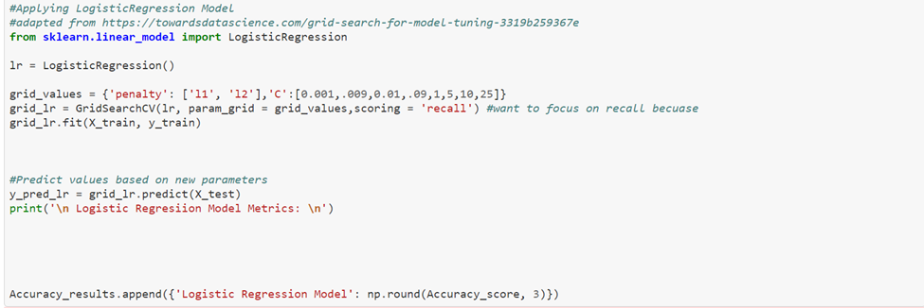
Log Regression

Slide 20
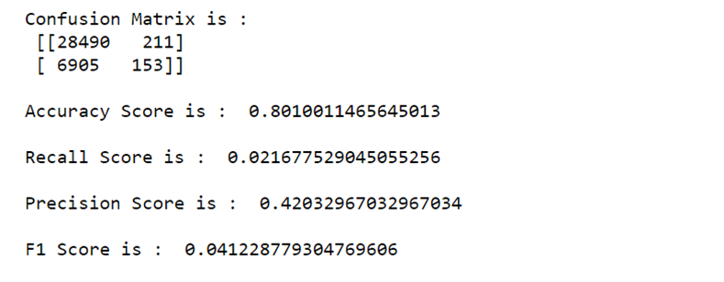
Confusion Matrix

Slide 21
How to Improve Models?
Target variable imbalance 80/20
Fix w/ SMOTENC
imblearn library

Slide 22
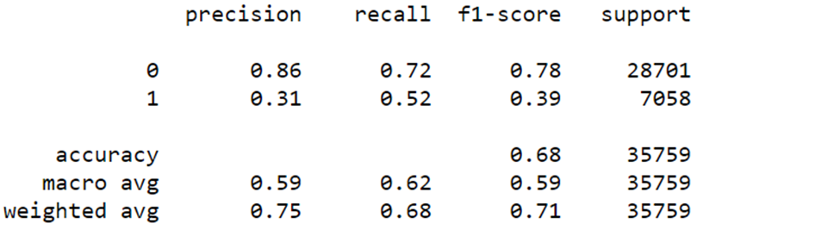
Post-Balancing Modeling Logression

Slide 23
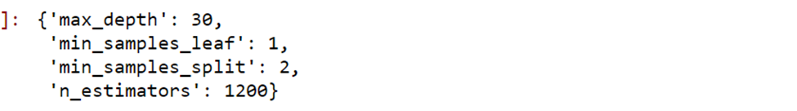
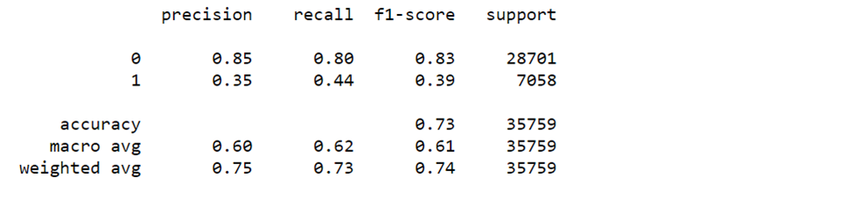
Post-Balancing Modeling
Best Score; 0.82170965237643404

Slide 24
Recommendations
If feasible recommend that they always SMS (auto-message)
Get dates of SMS and create interval for that
Re-model results
Message only when interval gets n-large

